Slide 1
Extract Review and Product from Tokopedia
Muhammad Hanif Fajari

Slide 2
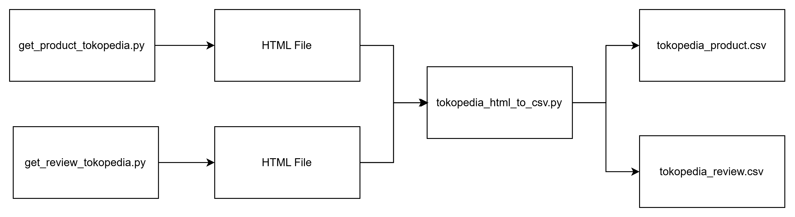
High Level Diagram

Slide 3
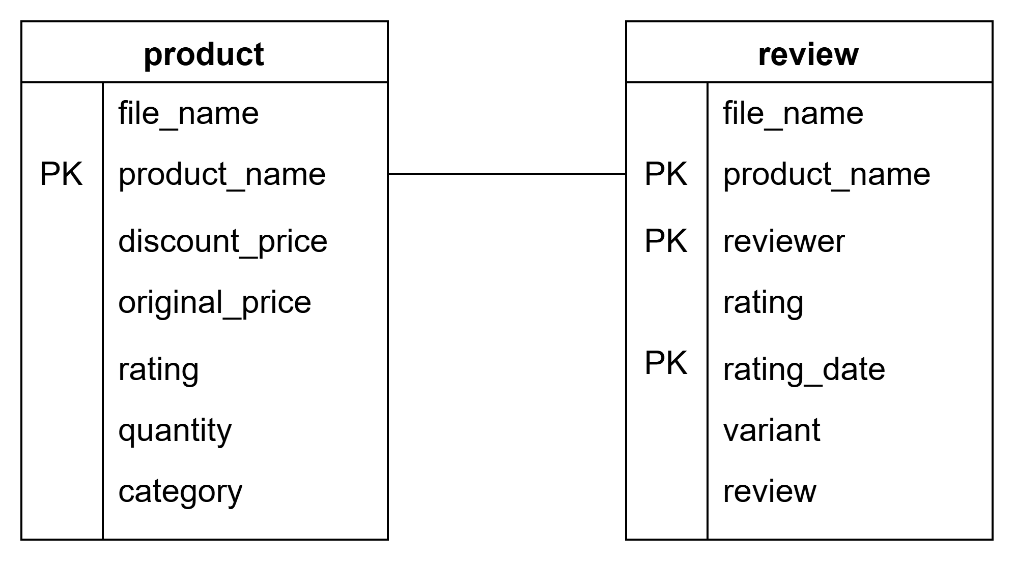
Table Diagram

Slide 4
Usability
This process can be used to analyze customer feedback, competitors, and product trends.

Slide 5
Future Improvement
Add logging for incremental load
Add integration to database
Add automatic categorization to make the process more dynamic and avoid hardcoding

